Slide 1
Spring MVC - DispatcherServlet

Slide 2
What is DispatcherServlet?
Single Entry Point: DispatcherServlet acts as the central entry for all incoming HTTP requests in a Spring MVC application, intercepting each request before it reaches any controllers.
Request Routing and Response: It determines which controller should handle the request by consulting handler mappings, delegates the request for processing, and then uses a view resolver to render the final response to the client.
Orchestration of Components: DispatcherServlet manages and coordinates key Spring MVC components—such as controllers, handler adapters, and view resolvers—to ensure modular, flexible, and efficient request processing and response generation.

Slide 3
Role of DispatcherServlet
Feature | Description
Shared Request Processing Algorithm | DispatcherServlet follows a standard process to handle requests but passes the detailed work to other components that can be changed or extended, making the handling flexible.
Integration with Spring Configuration | It uses Spring’s setup files (either XML or Java code) to find and start the parts needed to route requests, build responses, handle errors, and more—using Spring’s powerful tools behind the scenes.
Supports Multiple Handler Mappings | It can use many ways (like annotations or URL patterns) to decide which controller should handle a specific web request, making routing easy and adaptable.
View Resolution Management | After a controller runs, DispatcherServlet finds the right webpage or response template (like HTML or JSON) to send back to the user.
Exception Handling | If something goes wrong during processing, DispatcherServlet has ways to catch these errors and show friendly error messages instead of crashing.
Lifecycle Management | It sets up and manages a special Spring context just for web parts, keeping things organized and separate from other application parts.
Configurable via web.xml and Code | You can set up DispatcherServlet in traditional config files (web.xml) or by writing code in modern Spring Boot apps, so it fits different project styles and preferences.

Slide 4
Request Handling Workflow
When a user makes an HTTP request (such as visiting /products/list), the request first hits the DispatcherServlet.
DispatcherServlet determines the appropriate controller to handle this request by consulting one or more Handler Mappings that map URLs to controller methods.
Once the right controller is identified, DispatcherServlet delegates the request to that controller method.
The controller processes the request, prepares a model, and returns a view name.
DispatcherServlet then uses View Resolvers to find the actual view resource.
It finally merges the model data with the view, generates the final HTML, and sends it back as the HTTP response to the client.

Slide 5
Key Components of Dispatcher Servlet
Handler Mappings
Decide which controller method should process each request.
Handler Adapters
Allow different handler/controller methods to be invoked flexibly.
View Resolvers
Determine how to render the view based on the logical view name returned by controllers.
Exception Resolvers
Handle errors and return appropriate error views or messages.
Handler Adapters
Allow different handler/controller methods to be invoked flexibly.
View Resolvers
Determine how to render the view based on the logical view name returned by controllers.
Exception Resolvers
Handle errors and return appropriate error views or messages.

Slide 6
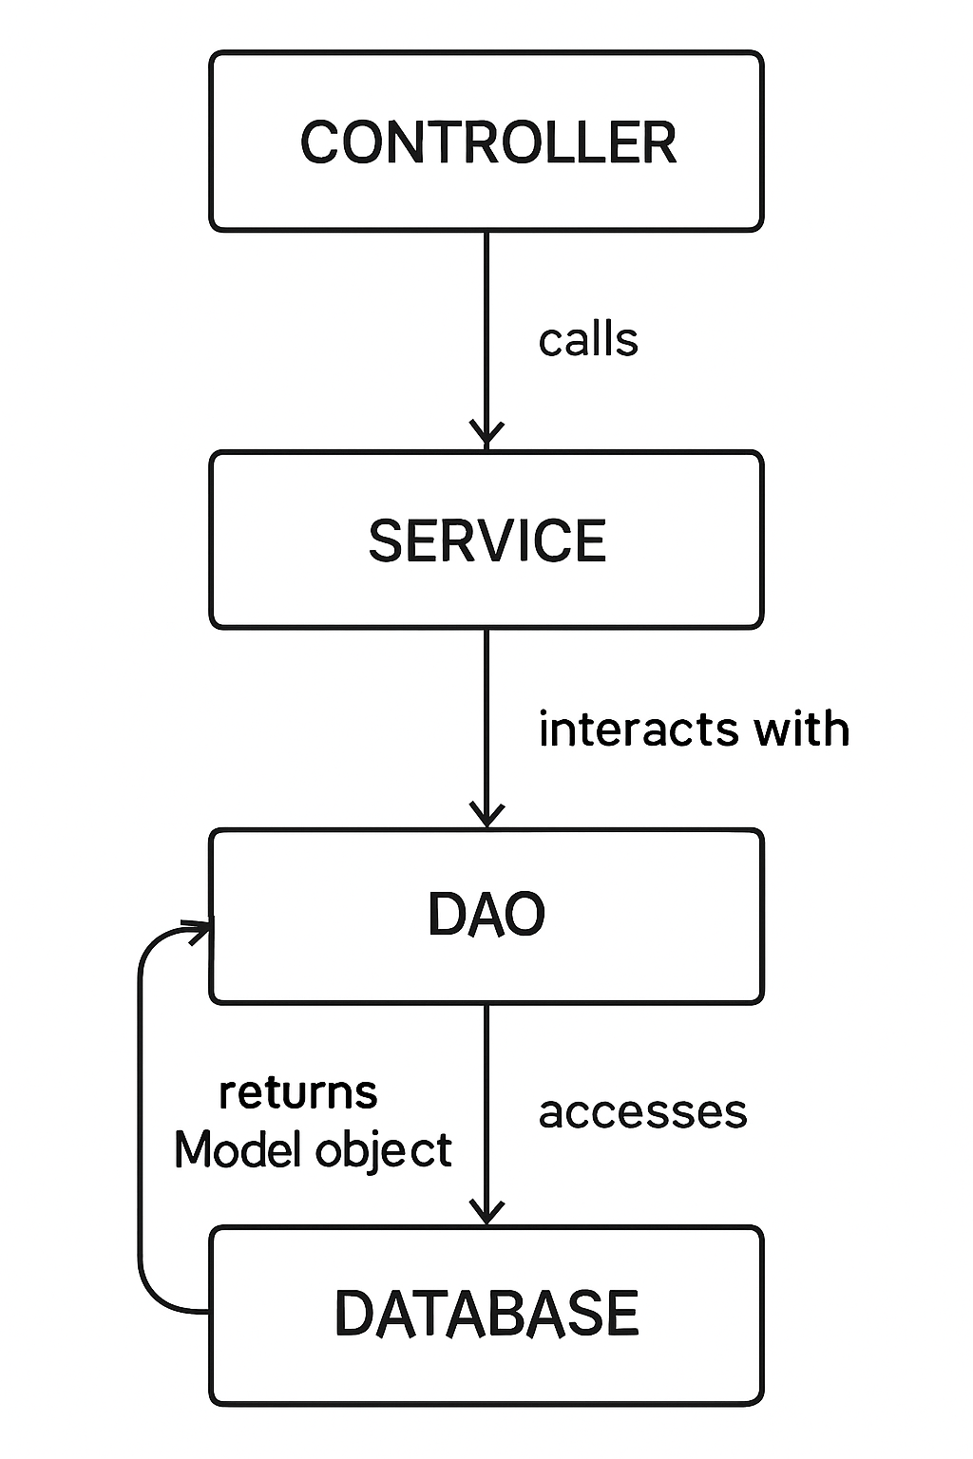
DispatcherServlet Flow
Client -> controller -> calls service layer ->interacts with the database with the help of DAO layer->returns data back to controller by passing through service layer -> which returns the data to the client

Slide 7
Springboot + DispatcherServlet
In Spring Boot, DispatcherServlet is automatically created and configured for you—no need to write any web.xml or manual servlet setup. DispatcherServlet acts as the main front controller, handling all incoming web requests, routing them to controllers, and generating responses.
Spring Boot advantage:
DispatcherServlet is set up by default, and you just write controller classes.
You can customize its settings by adding configuration in your Java code or application properties if needed.
This makes web development faster, easier, and less error-prone while still getting the full features of DispatcherServlet as in classic Spring MVC.

Slide 8
Traditonal and Modern Dispatcher Servlet
Feature | dispatcher-servlet.xml | AppDispatcherServlet (Java Config)
What it is | An XML file that sets up Spring MVC | A Java class that sets up Spring MVC
How it’s set up | Declared in web.xml | Registered in code via WebAppInitializer
Syntax | XML tags | Java code with annotations
Type safety | Low – errors show only at runtime | High – errors can be caught at compile time
Refactoring | Hard – changing names can break XML | Easy – IDE supports renaming and refactoring
Controllers & Views | Configured in XML | Configured in Java code (@Controller, @Bean)
Customization | Limited to what XML allows | Fully customizable in code
Spring Boot friendly | Not ideal | Works perfectly with Spring Boot
Modern practice | Old / legacy way | Recommended for new projects

Slide 9
Summary of DispatcherServlet
Browser → User types http://localhost:8080/hello
👉 Browser just shoots an HTTP request.
Tomcat → Acts like a post office.
👉 Sees web.xml mapping → "/ should go to DispatcherServlet".
DispatcherServlet → Think of it as the traffic police / receptionist.
👉 Doesn’t do business logic itself. Just decides: "Which controller will handle this?"
HandlerMapping → Works like a phone directory.
👉 It looks at all controllers and finds: "/hello is handled by HelloController".
Controller → The actual worker / service desk.
👉 Runs your logic (like fetching data, preparing Model). Returns → "hello.jsp" (view name).
ViewResolver → Works like a translator.
👉 It converts "hello" into WEB-INF/views/hello.jsp.
JSP (or View) → The painter.
👉 Mixes Model data + JSP template → creates final HTML.
Browser Response → Final painted HTML page sent back.
👉 User sees it on the screen.

Slide 10
What Are Controllers in Spring?
A Controller is a class marked with @Controller (for web pages) or @RestController (for REST APIs).
It receives HTTP requests (GET, POST, etc.), processes user input, talks to the service/business layer, and returns a response such as an HTML page or JSON data.
Controllers keep the web layer separate from business and database logic—helping organize code and making maintenance easier.

Slide 11
HTTP Requests used in Controllers
GET: Used to retrieve data from the server. It does not change anything on the server and is mainly for reading information.
POST: Used to send data to the server, such as creating a new record or submitting a form. This can update or create resources.
PUT: Used to update or replace existing data on the server, usually replacing the entire resource.
DELETE: Used to remove data from the server.
PATCH: Used to make partial updates to existing data, changing only the specified fields rather than replacing the whole resource.
OPTIONS: Used to discover which methods and operations are allowed for a particular resource.
HEAD: Like GET, but only returns response headers—not the actual body/data.
CONNECT: Used to establish a tunnel to the server (rarely used in normal web apps).
TRACE: Used for debugging, returns the request as received by the server.

Slide 12
How Controllers Work
Working of Controllers in Spring MVC (Simple Flow)
Client Request → User/browser sends request (/hello, /users).
DispatcherServlet → Intercepts and finds the right controller method.
Controller Method → Executes, may call Service/DAO using @Autowired.
Return → Sends back a view name (JSP/HTML) or data (JSON/XML).
ViewResolver (if MVC) → Maps view name to actual page.
Response → Final result is sent to client.

Slide 13
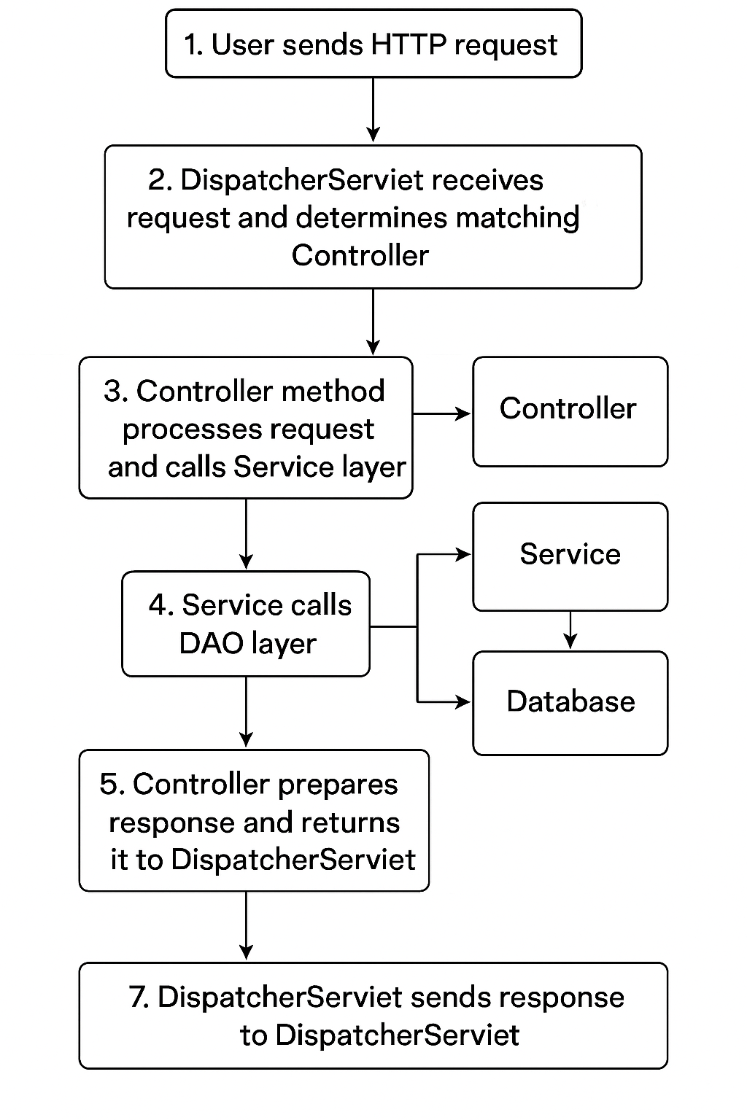

Slide 14
RequestMapping
Definition:
Annotation used in Spring MVC to map HTTP requests to controller methods.
Where used:
Class level → defines base URL.
Method level → defines specific path & behavior.
Purpose:
Route incoming requests to correct method.
Control request method, parameters, headers, and data format.

Slide 15
Key attributes of @RequestMapping
Attribute | Description | Example
value / path | URL mapping | @RequestMapping("/hello")
method | HTTP Method | @RequestMapping(value="/save", method=POST)
params | Match request params | params="type=admin"
headers | Match request headers | headers="content-type=application/json"
produces | Response type | produces="application/json"
consumes | Request type | consumes="application/json"

Slide 16
View Resolver
In Spring MVC, when your controller returns a string (logical view name), the ViewResolver maps that string to an actual view (JSP, Thymeleaf, etc.) that should be rendered to the client.
Without a ViewResolver, Spring would not link Spring MVC, the controller methods do not return actual view files (like home.jsp).
Instead, they return a logical view name (a simple string, e.g., "home").
The ViewResolver is a component that translates this logical view name into the actual view resource (such as JSP, Thymeleaf, FreeMarker, or PDF).
It works closely with the DispatcherServlet to find and render the correct UI.
Usually, a prefix and suffix are configured in the ViewResolver:
Prefix = /WEB-INF/views/
Suffix = .jspnow where your JSP/HTML/Thymeleaf files are located.
How it Works
User goes to http://localhost:8080/home
Controller returns "home"
ViewResolver converts "home" → /WEB-INF/views/home.jsp
JSP file is rendered with ${message} → "Welcome to Spring MVC!"

Slide 17
Flow of ViewResolver in Spring MVC
Step | Explanation | Data/Example
1. User Request | User accesses the application URL. | http://localhost:8080/home
2. Controller Executes | DispatcherServlet finds the right controller and method runs. | Controller returns → "home"
3. ViewResolver Resolves | Maps logical view name to actual file using prefix & suffix. | "home" → /WEB-INF/views/home.jsp
4. JSP Rendered | JSP file executes with model attributes. | ${message} → "Welcome to Spring MVC!"
5. Response Sent | Final HTML is sent back to the client’s browser. | Rendered HTML page

Slide 18
Form Handling in Spring MVC
Definition:
Form handling in Spring MVC allows users to submit data through HTML forms, which the controller captures, validates, and processes.
Key Concepts:
Form backing object → Java model class (e.g., User).
Form tag library (<form:form>) for binding inputs.
Data Binding → Form fields ↔ Object properties.
Validation → Check input with @Valid and BindingResult.

Slide 19
Workflow of Form Handling
Step | Explanation | Data/Example
Show Form | Controller displays form page. | GET /register → register.jsp
Fill Form | User enters details in HTML form. | Name = “Yukti”, Email = “abc@test.com”
Submit Form | Form data posted to controller. | POST /register
Data Binding | Spring binds form fields to model object. | User{name="Yukti", email="abc@test.com"}
Validation | @Valid checks rules; errors go to BindingResult. | If empty → error message
Processing | Controller calls Service/DAO. | Save user to DB
Response | Success/Failure page shown. | Redirect → /success

Slide 20
Validation in Spring Boot
Definition:
Validation ensures that user input is correct, safe, and consistent before processing.
Spring Boot Support:
Uses Jakarta Bean Validation (JSR-380) with Hibernate Validator as the default provider.
Annotations are applied directly on model fields.
Key Benefit:
Prevents invalid data from entering the application (database, business logic, etc.).

Slide 21
Common Validation Annotations
Annotation | Usage | Example
@NotNull | Field must not be null | @NotNull private String name;
@NotEmpty | String/Collection must not be empty | @NotEmpty private String username;
@Size | Length/size constraints | @Size(min=2, max=30)
@Email | Valid email format | @Email private String email;
@Min / @Max | Min/max value for numbers | @Min(18) private int age;
@Pattern | Regex validation | @Pattern(regexp="\\d{10}")

Slide 22
What is @ControllerAdvice
Definition:
@ControllerAdvice is a special Spring annotation used to handle exceptions globally across the whole application.
Purpose:
Centralized error handling.
Avoids repeating try-catch blocks in each controller.
Improves clean code and maintainability.
Works With:
@ExceptionHandler (handle specific exceptions)
@ModelAttribute, @InitBinder

Slide 23
How Controller Advice works
Step | Explanation | Example Data
1. Exception Occurs | User request triggers an error inside Controller. | UserNotFoundException
2. DispatcherServlet | Forwards exception to Spring’s exception resolver. | Error caught
3. @ControllerAdvice | Class annotated with @ControllerAdvice intercepts it. | Global handler class
4. @ExceptionHandler | Method inside advice decides response (JSON/View). | Returns error JSON
5. Response Sent | User gets a clean error response instead of stacktrace. | { "error": "User not found" }

Slide 24
Spring MVC Summary
DispatcherServlet
Central front controller.
Routes every request to the right handler.
Controllers & RequestMapping
Controllers process requests.
@RequestMapping, @GetMapping, @PostMapping map URLs → methods.
ViewResolvers
Convert logical view names → actual views (JSP, Thymeleaf).
Example: "home" → /WEB-INF/views/home.jsp.
Form Handling & Validation
Bind user input to model objects.
Validate using annotations (@NotEmpty, @Email, etc.).
Prevent invalid data in system.
Exception Handling with @ControllerAdvice
Centralized error handling across controllers.
@ExceptionHandler methods return clean responses.

